Slide 1

Diabetes
“Diabetes has become one of the biggest health challenges of our time, with 3.7 million people living with diabetes in the UK and 7 million people at high risk of developing Type 2 diabetes. Numbers are rising rapidly with 140,000 new diagnoses each year and it is estimated that over 5 million people in the UK will have diabetes by 2025 . Around 3 people are diagnosed with diabetes every 10 minutes in the UK .The prevalence of diabetes is nearly 4 times higher than the prevalence of all cancers combined and is still rising .”
The role of local authorities in health issues (8th March 2013) (parliament.uk)

Slide 2
Goals and reasons of analysis
Health reforms brought in by the Health and Social Care Act 2012 meant that local authorities have a duty of care to take appropriate steps to improve the health of the people in their area.
Our aim was to identify the most predictive risk factors associated with diabetes in order to help local authorities in developing and implementing strategies to define risk groups and tackle risk factors of illness.

Slide 3
Data analyst group
Jev Pigozne
Anike Olusanya

Slide 4
Data and analysis
4 datasets
253 680 individuals
22 metrics
socio-demographic
behavioural factors
medical history
Focus on the socio-demographic and behavioural factors which had the greatest impact on diabetes and the risk factors which could lead to diabetes:
Age
Sex
BMI
Physical activity
Income
Education

Slide 5
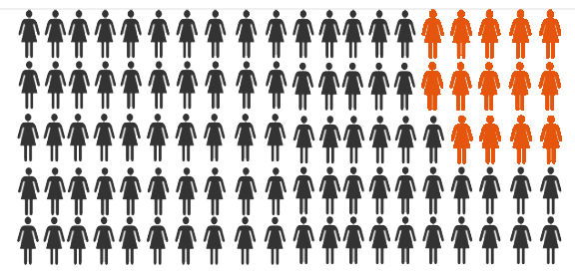
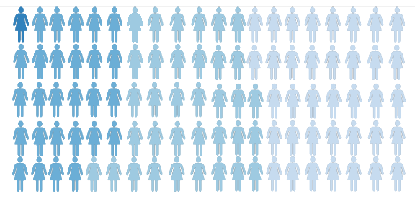
Diabetes and obesity
14% diabetic
1% underweight
27% normal
35% overweight
37% obese
BMI groups:
Underweight BMI below 18.5
Normal BMI 18.5 - 24.9
Overweight BMI 25.0 – 29.9
Obese BMI above 30.0

Slide 6
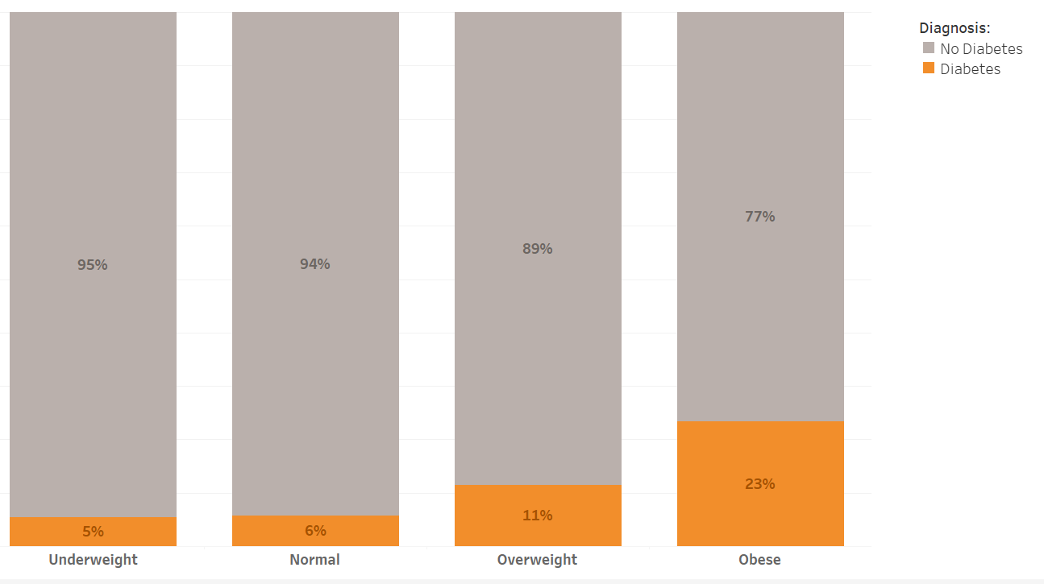

Percentage of diabetes in different BMI groups
BMI groups:
Underweight BMI below 18.5
Normal BMI 18.5 - 24.9
Overweight BMI 25.0 – 29.9
Obese BMI above 30.0

Slide 7
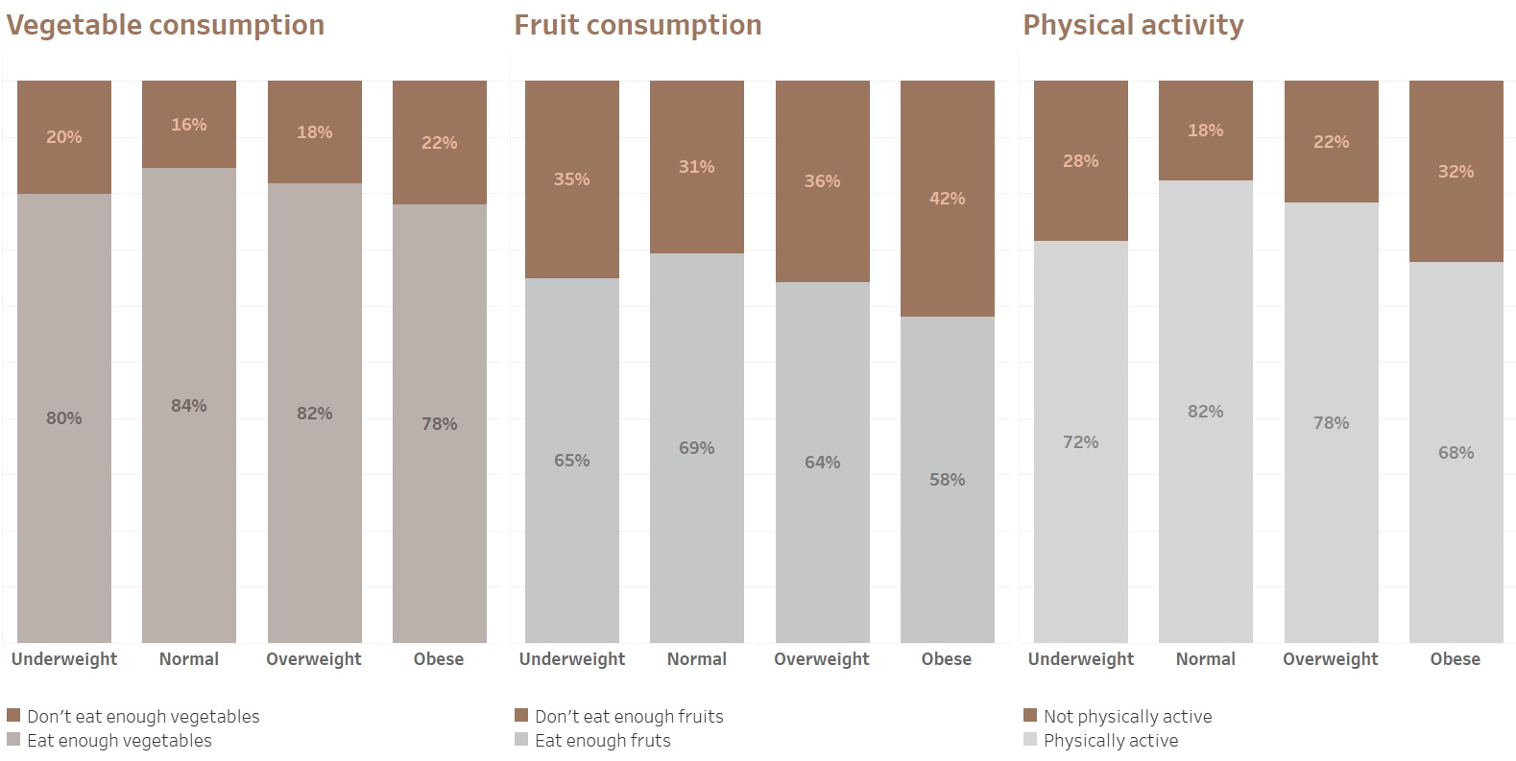


Obesity reasons

Slide 8
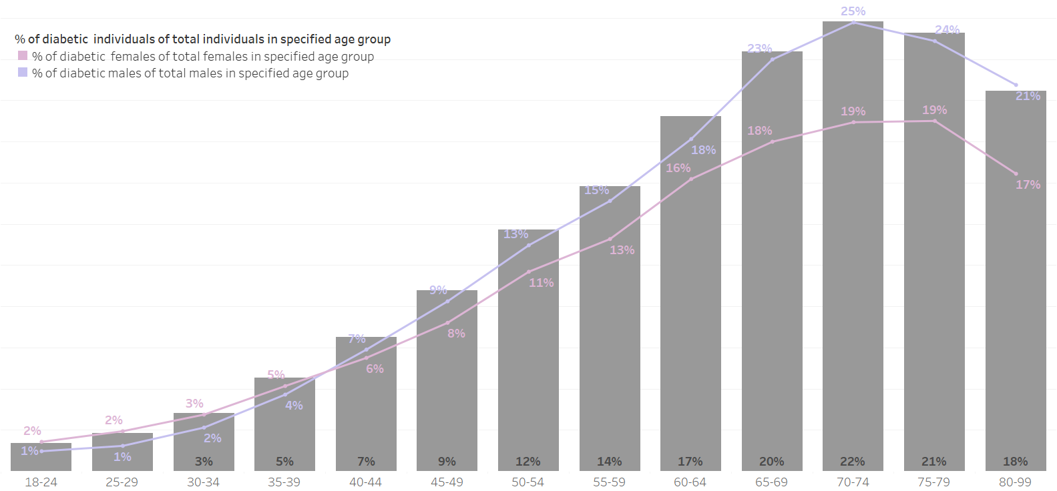



Percentage of diabetes in different age groups Difference between male and female
6%
Male diabetes overtakes female diabetes

Slide 9
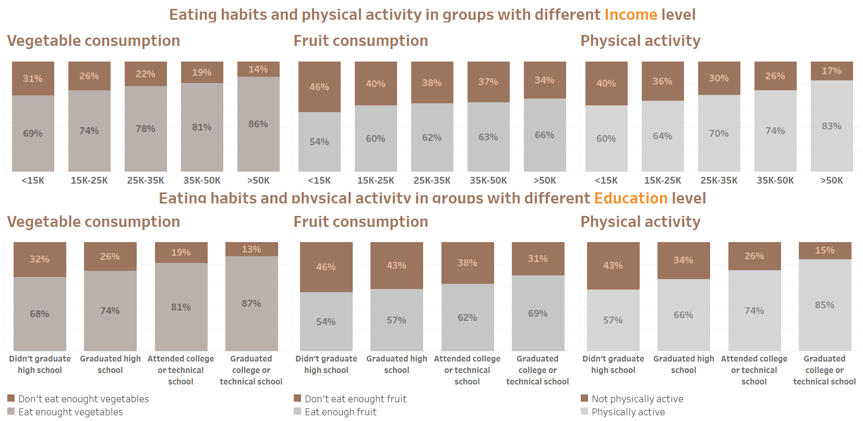


Underlying reasons Income and Education

Slide 10
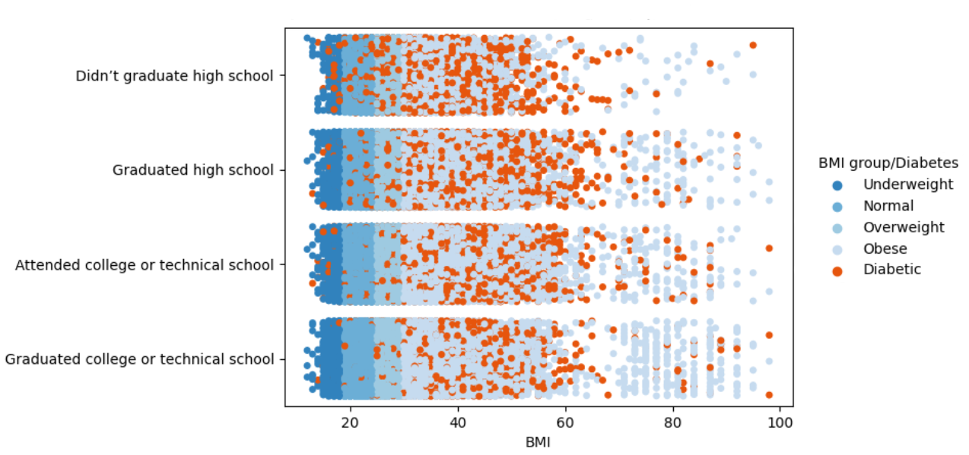
Diabetes distribution in groups with different education level Diabetes in different BMI groups of different educational levels

Slide 11
Recommendations
Promote healthy eating and physical activity
Raise awareness of the risk factors associated with Type 2 diabetes
Highlight the importance of seeking a diabetes risk assessment and the benefits of early diagnosis
Target all income ranges but special attention should be given to those on lower incomes
Start as early as possible, ideally at primary school level

